Slide 1
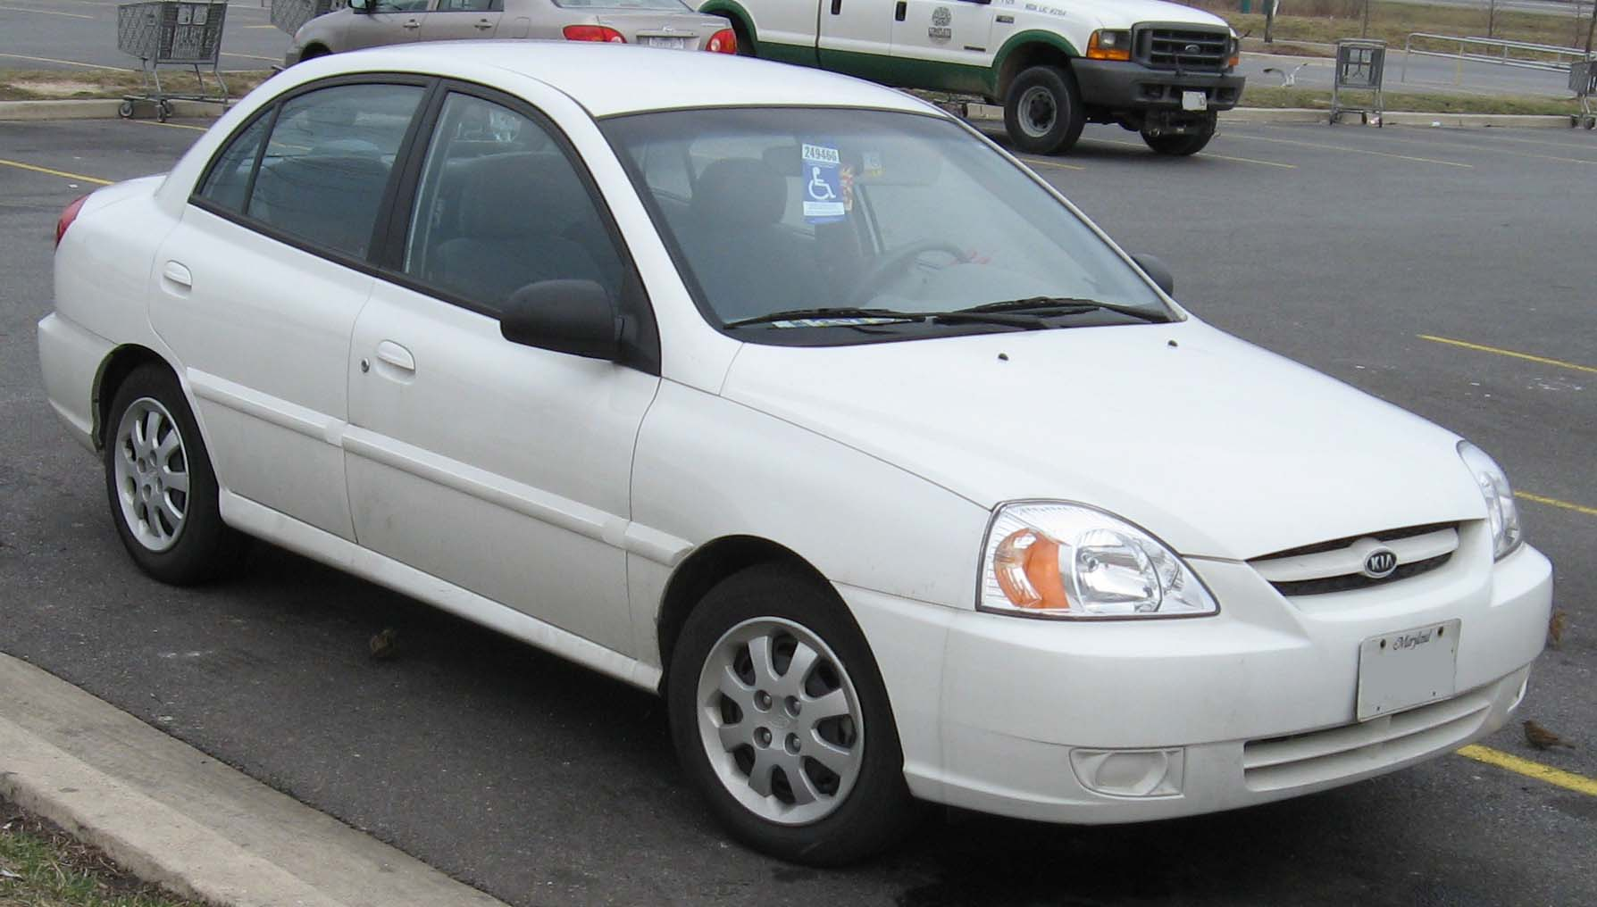
Come On. We can do this…
This Photo by Unknown Author is licensed under CC BY-SA
Or…Hire the Expert.
Notes:
This Photo by Unknown Author is licensed under CC BY-NC-ND

Slide 2
“Two Hours to Change a Lightbulb?”
This Photo by Unknown Author is licensed under CC BY-SA
Notes:
https://www.youtube.com/watch?v=5hf2umYCKr8

Slide 3
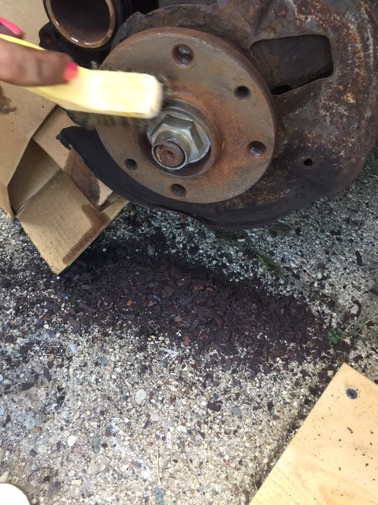
Rust? What rust?
This Photo by Unknown Author is licensed under CC BY-NC-ND
Notes:
This Photo by Unknown Author is licensed under CC BY-NC-ND

Slide 4
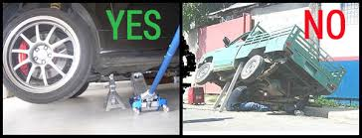
All Jacked Up and Nowhere to Go…

Slide 5
Napa
This Photo by Unknown Author is licensed under CC BY-SA
Or Napa Valley- wine from the belly button…
Notes:
This Photo by Unknown Author is licensed under CC BY-NC-SA

Slide 6
Rotor and pads are in!
Floating rotors? JK.

Slide 7
Done? Not so fast…

Slide 8
Hire the expert.
This Photo by Unknown Author is licensed under CC BY-SA

