Slide 1
Cultivate Listening by Taru Nieminen Toastmasters 6/22/2017

Slide 2
“One of the most sincere forms of respect is actually listening to what another has to say.” —Bryant H. McGill
!
?

Slide 3
“Listening is an art that requires attention over talent, spirit over ego, others over self.” —Dean Jackson

Slide 4
“Every good conversation starts with good listening”

Slide 5
“The first duty of love is to listen.” —Paul Tillich

Slide 6
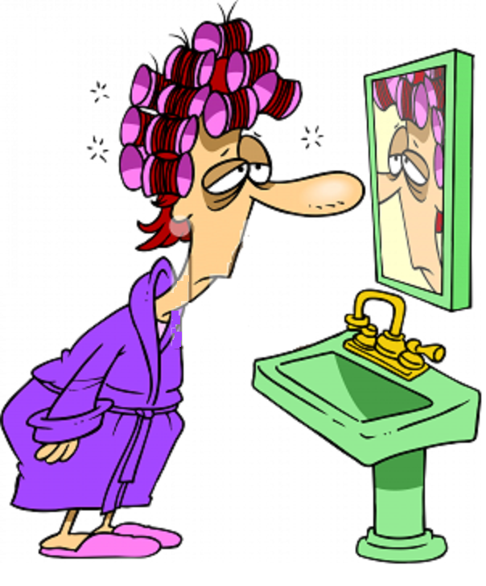
“When a woman is talking to you, listen to what she says with her eyes.” —Victor Hugo
“You snored all night….”

Slide 7
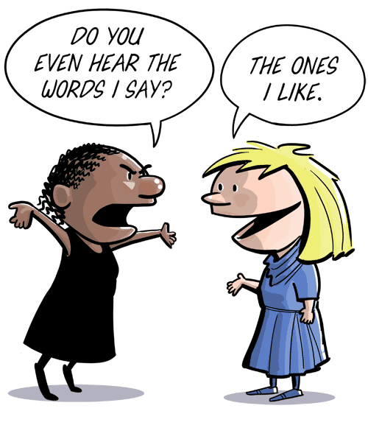
Thank you for listening.

